Slide 1
Accountable Breast Cancer Classification
Cancer and Neural Networks: Takes a Black Box to Know One
Saqib Nizami
DSI-US-4
Capstone : Lay Overview

Slide 2
Objective
“
What features are deemed important for cancer classification by convolutional neural networks?
”

Slide 3
Impact
Faster classification of cancer grades
Not a replacement of physician diagnosis
Acts more like an adjuvant to diagnosis
→ interpretability is paramount

Slide 5
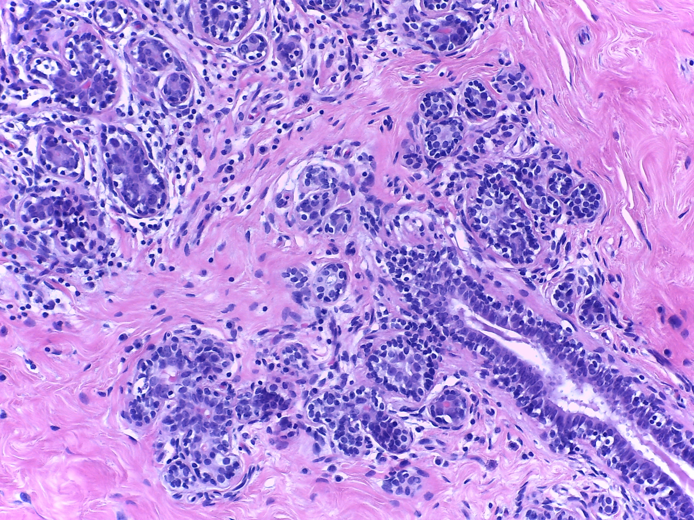
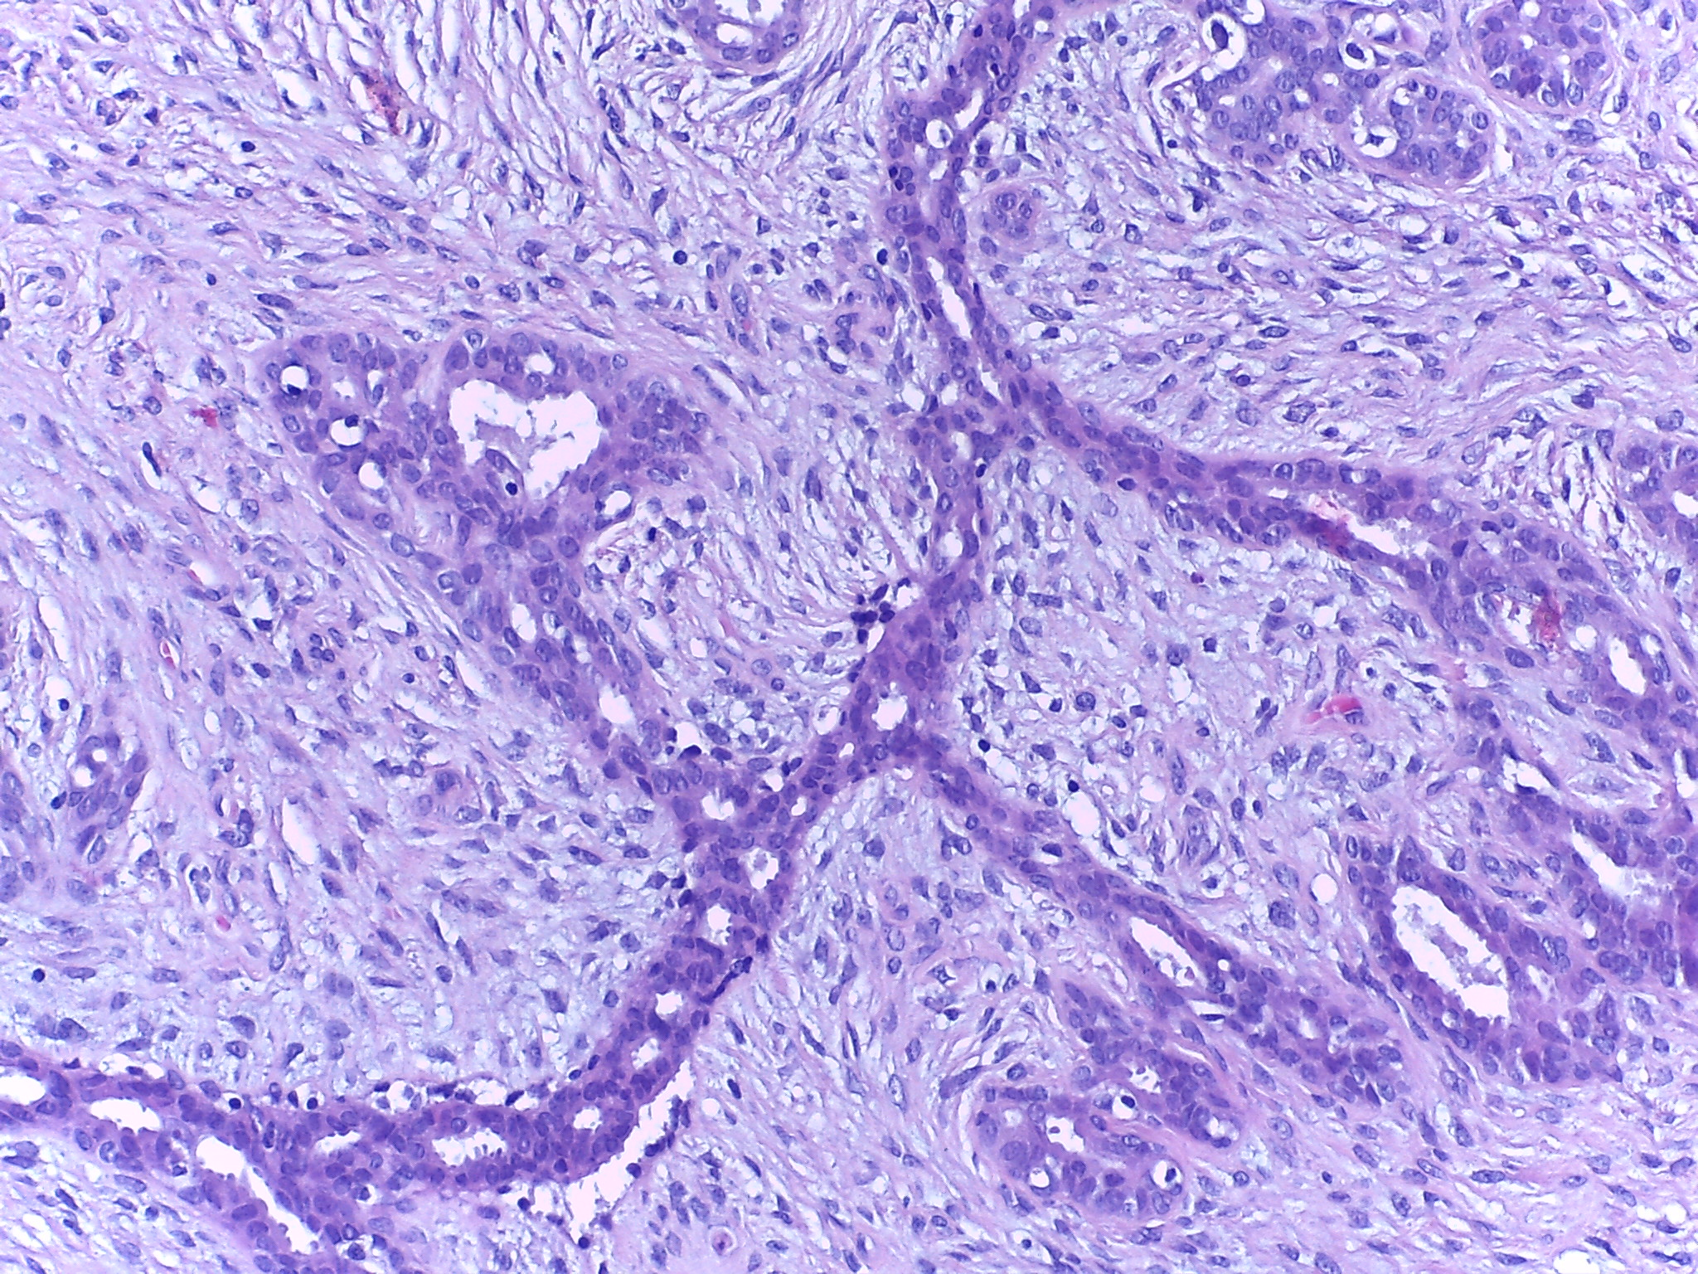
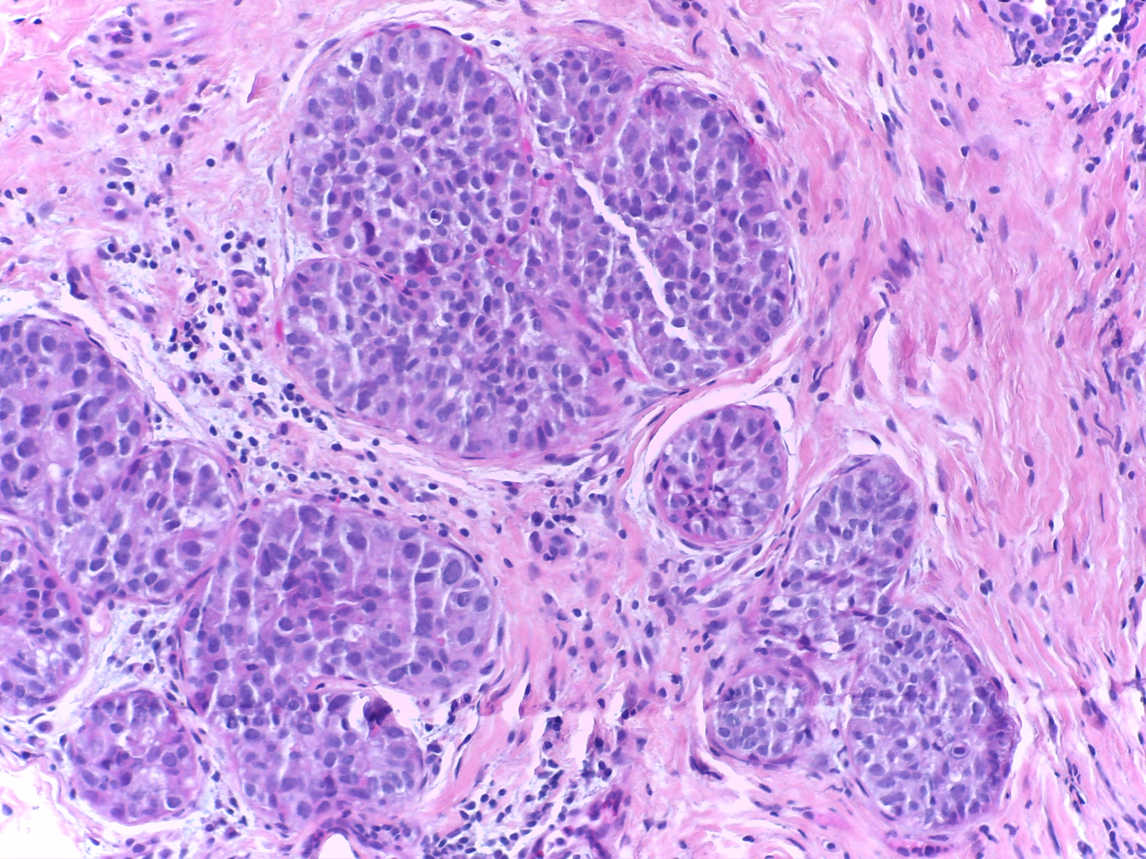
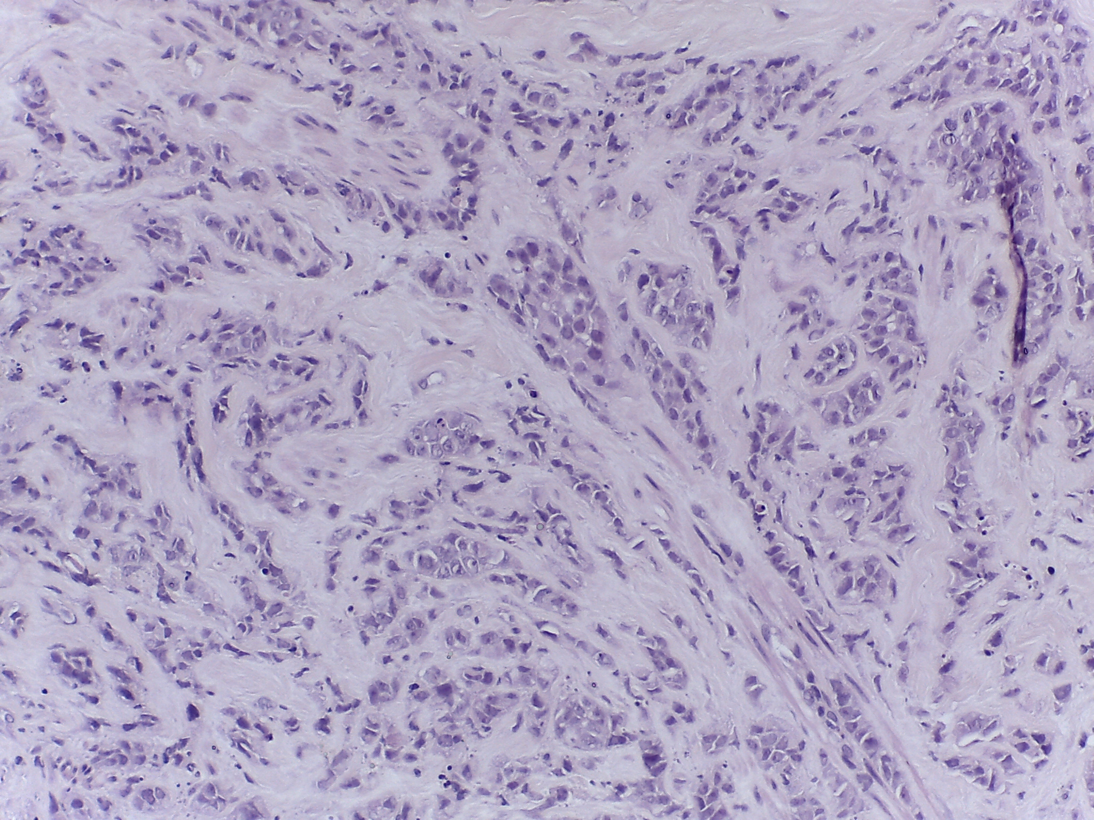
NORMAL
BENIGN
INSITU
INVASIVE

Slide 6
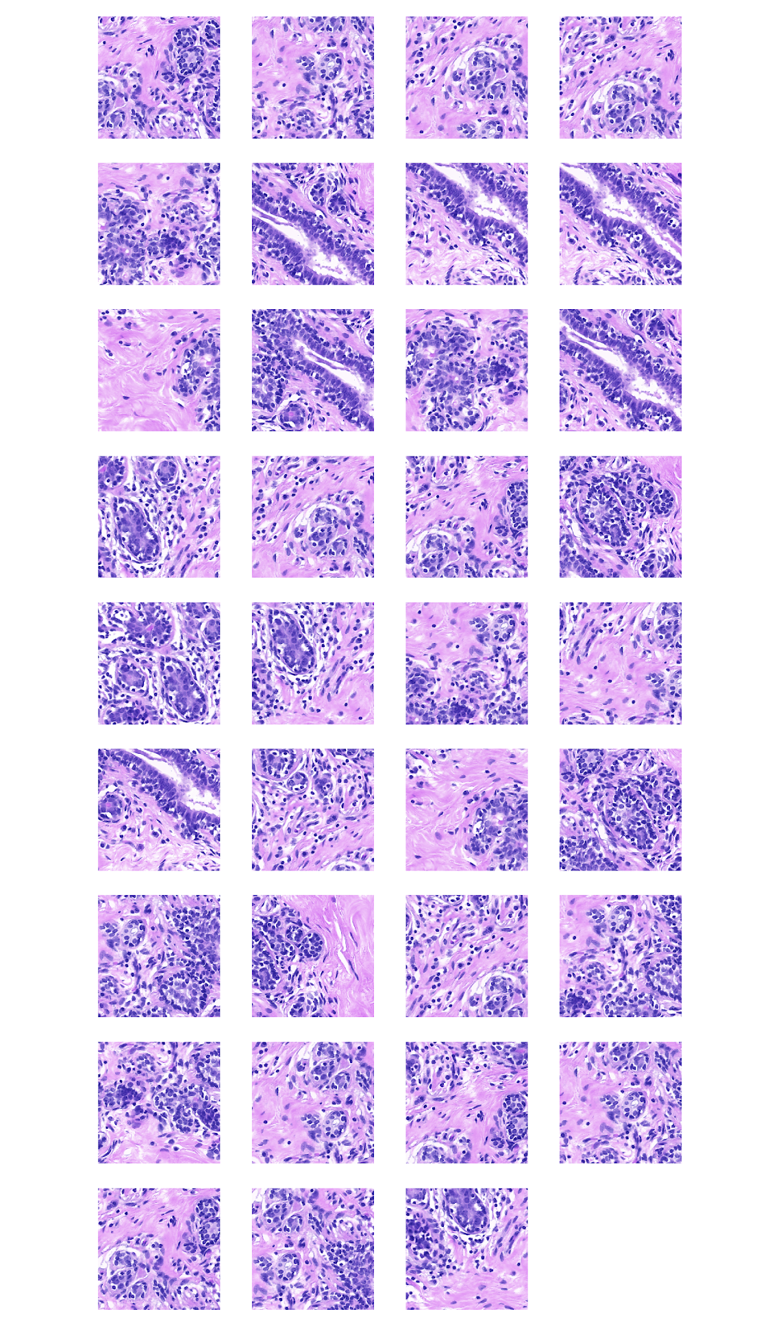
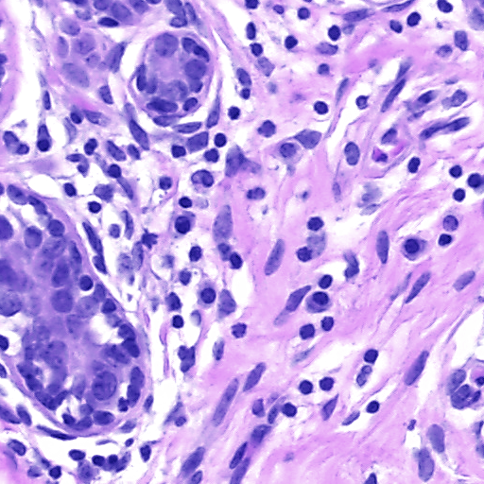
NORMAL

Slide 10
LIME

Slide 11
ELI5

Slide 12
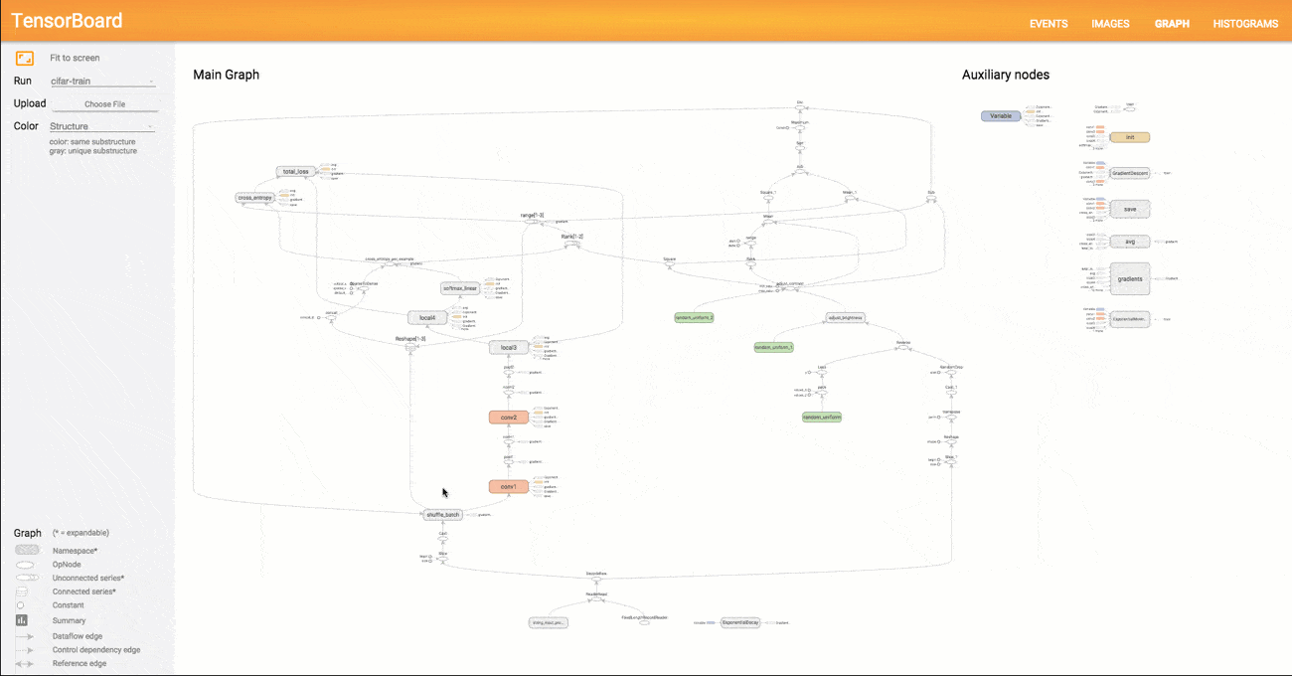
TENSORBOARD

Slide 13
LIME

